Slide 1
PARALLEL UNIVERSE: We’re not in Kansas anymore, Toto
Presented to Job Seekers Network
Monday, June 7, 2021
By Kathy Lansford
Notes:
For years, as part of my new member orientation at Launch Pad, I have been telling job seekers they may not realize it but they have all crossed over into a parallel universe that is not governed by logic. Sometimes they have the best resume, they answered every question correctly, yet here they sit while someone with a fraction of their qualifications got the job that should have been theirs. Today, I’m going to take a deeper dive into that phenomenon, and we’ll compare your parallel universe to Dorothy’s as she travels through the Land of Oz.

Slide 3
The Logical Life
Misbehave → Time out
Study + homework → Good grades
Good grades → Good school and scholarships
Graduation from good school with good grades → Good job
Work hard at good job → Raises and promotions
Dorothy: Feed the chickens → Have eggs for breakfast
Notes:
Note that in a logical life, you have control over the actions which also gives you control over the outcome.

Slide 4
Disruption
New management
Virus outbreak
Loss of major contract / customer
No longer stellar performance evaluations
PIP (Performance Improvement Plan)
Planned reorganization
Dorothy: Storm is a’comin’
Notes:
In this case, disruption is not the good kind. It’s change over which you have no control that has a major impact on your life.
With PIP, tell story of woman who asked if her PIP was preliminary to termination and if so, what had she done to warrant that. Her manager assured her that was not the case. They wanted her to take some training because they wanted her to more into a more responsible position. A few days later, she was let go.

Slide 5
No control over events that impact your life
You
Dorothy

Slide 6
THE EVENT
You have no job
Dorothy: You’re not
in Kansas anymore

Slide 7
1st Logical Thought: I can do this!
Education
Experience
Achievements
Personal strengths
References
Savings
Dorothy: I’ll just find someone to ask for directions

Slide 8
Parallel Universe: Not governed by logic
You:
Dorothy:

Slide 9
The Logical Life
You spend 10 hrs/day applying to jobs
You paid a professional $250 for your resume
You applied to 300+ job postings
Result: Zero interviews
Finally, you start getting interviews,
sometimes 5 interviews for one job
Result: Zero job offers
Dorothy: Only the Wizard can help you. Oops. He’s a fake.

Slide 10
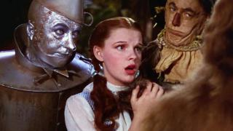
Confidence crisis
You: I’ll never find
another job.
Dorothy: Toto, we will
never get out of Oz.

Slide 11
How to navigate and thrive in a parallel universe

Slide 12
1. Join a job search team
Team goals
Accountability
Support and encouragement
Share leads, connections, ideas
Social interaction
Minimal whining
Dorothy: These guys

Slide 13
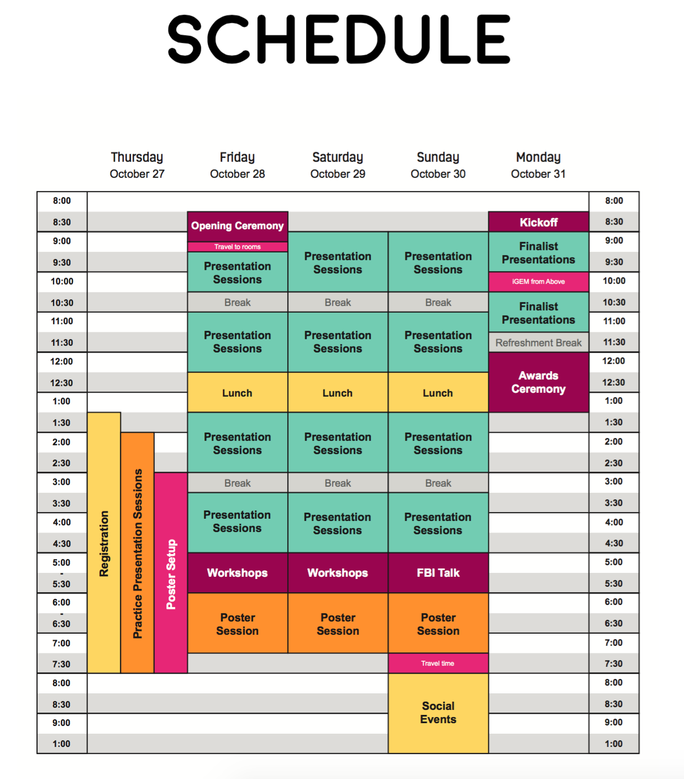
2. Create a routine
6:00-7:00 am – Exercise /Meditation
7:00-8:00 am – Ablutions, breakfast
8:00-9:30 am – Online course (Coursera, Udemy)
9:30-10:00 am – Check emails and voice mails
10:00-10:15 am – Break
10:15-12:30 pm – Job search / apply for jobs
12:30-1:00 pm – Lunch
1:00-3:00 pm – Networking / LinkedIn / Info interviews
3:00-5:00 pm – Job search / Volunteering
This Photo by Unknown Author is licensed under CC BY

Slide 14
3. Set reachable goals
Daily
Weekly
Monthly
SMART (Specific, Measureable, Achievable (within your control), Relevant, Time-based)
Notes:
A goal of I will be employed by July 4 is not necessarily achievable because it is not within your control. But you could say you will apply for 20 jobs between now and July 4.

Slide 15
4. Join up! Speak up!
Toastmasters
Leap to Success
Job Clubs
Meetup.com
- Python User Group
- Women Empowering Women in Nature
- Sierra Club
- Women Who Code
- Product School
- Tableau User Group
- Agile Austin
Notes:
Tell about Woody and his uhs and ums on BigInterview, led to his joining Toastmasters. Emphasize how important it is that people be active in the organizations or at least be participatory during the meetings.

Slide 16
5. Volunteer
Where?
- A cause you care about
- A job utilizing your skills
How?
- https://kut.org/get-involved
- https://volunteermatch.org
Why?
- Helping / Making a difference
- HUGE boost to your confidence
- Great way to network
- Companies like to hire folks who give back

Slide 17
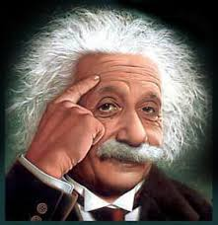
6. Talk to a smart person every day. Thom Singer
Be respectful of their time.
Be prepared with questions.
- Their career path
- Industry trends
- Advice for you (resume, job search)
- Company culture
- Recommendations for other smart people
Send thank you with follow-up regarding their suggestions.

Slide 18
7. Make time of unemployment most productive
What skill(s) did you learn or improve?
What people or causes did you help?
What steps did you take toward better health?
What did you do to help your immediate family?
What did you do to help your neighbors, coworkers,
or friends?
What did you do to help your community?
What did you do to help Texas?
What did you do to help your country?
What did you do to benefit the world?

Slide 19
8. POSITIVELY REFRAME EVERYTHING
Successes and lessons
At the end of every day, celebrate 3 good things that happened.
“I didn’t get discouraged and tried to learn everything I could and made adjustments after every (failed) interview.” Woody Woodcock, hired after 1 year
“I feel so lucky to have NOT been chosen for previous positions because this one is SO perfect for me.” Joanna Ward
“If they hired someone else, that is one less person you have to compete with. Don’t sweat it, your next job is out there.” Carey Lynch, hired after 4 months.

Slide 20
9. Keep an open mind. Learn from everybody.
Take advantage of every bit of free training that is available; go to all the classes offered by each of the big three job clubs. If the advice is contradictory, follow the approach that makes the most sense to you.
Attend webinars, ACC Strategies classes, WorkinTexas classes, and events posted on Eventbrite.
Connect with speakers through LinkedIn. Follow up with a request for a conversation. Create a mutually beneficial relationship.
Endorse and recommend people on LinkedIn. Often, they will reciprocate.
Take a lifeboat job if you need the money or just want to work. No need to talk about it in the interview.
Notes:
Tell the story of David Clune and/or Ken Koldan.

Slide 21
Ultimately, you already have the power.
You: Keep learning, applying, networking, helping. Repeat until hired.
Dorothy: Click those ruby slippers and
repeat, “There’s no place like home.”

